Slide 1
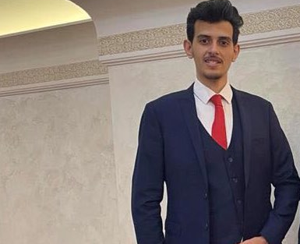
IYAD SAADEH
Full Stack JavaScript Developer

Slide 2
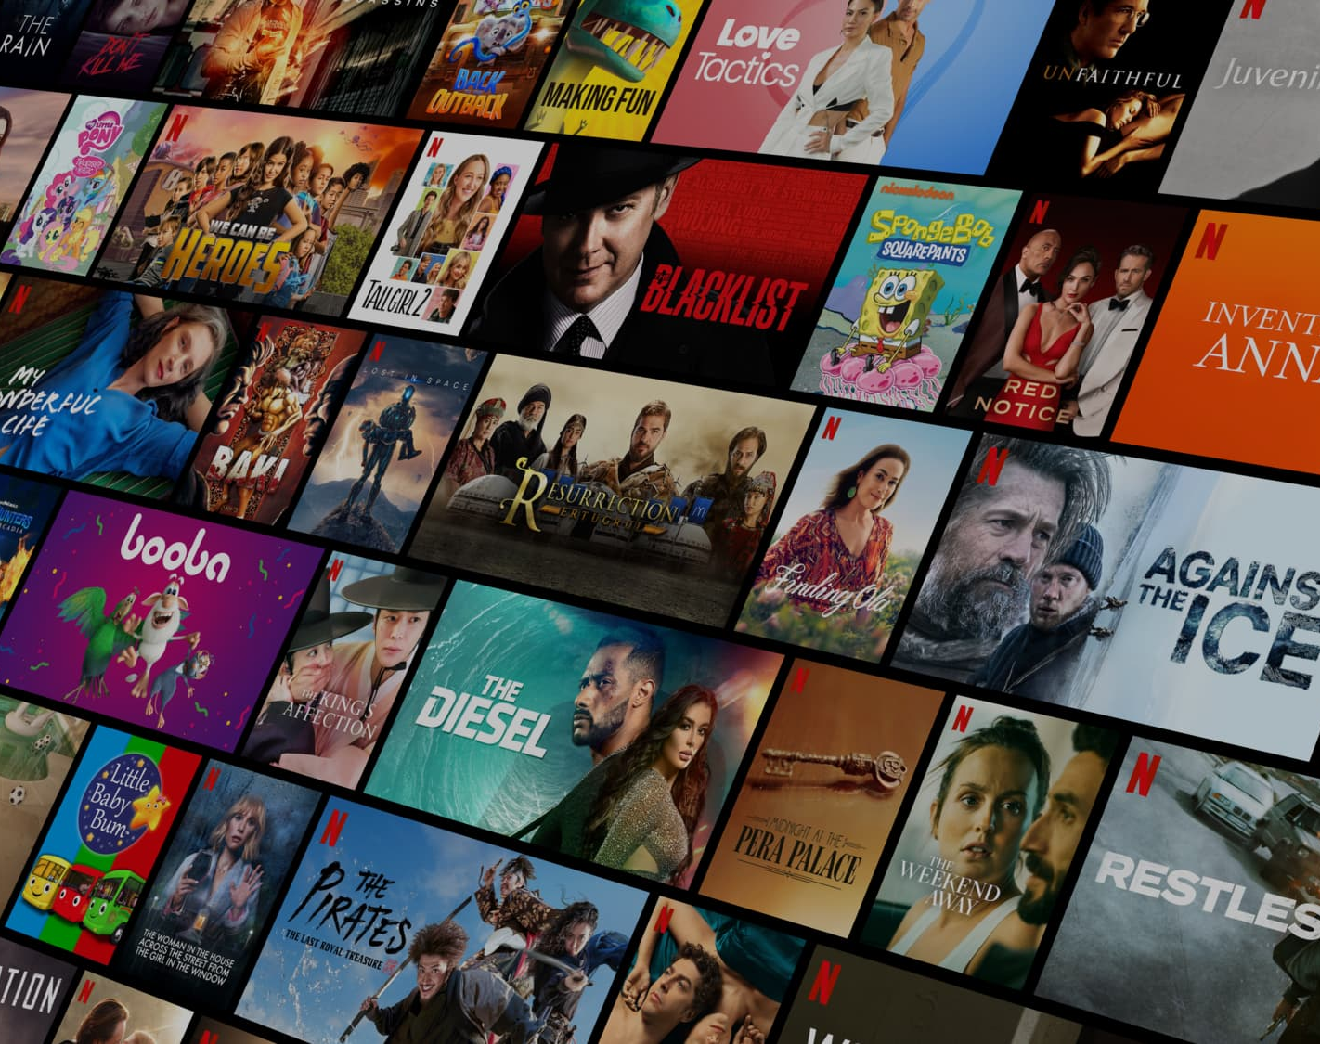
Netflix Clone
Project 6

Slide 3
How we did it ?
Trello
1
WireFrame
2
ERDiagram
3
Start
4

Slide 4
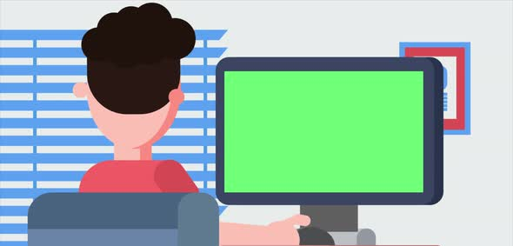
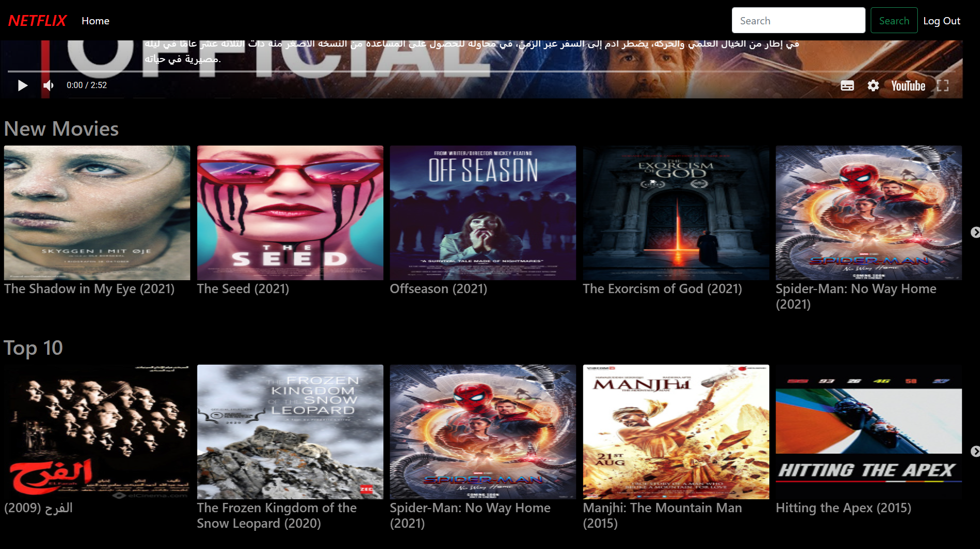
Demo

Slide 5

What went well ?
Build The backend .
Build The FrontEnd .

Slide 6
The End
Thank You For Listening

